Slide 1
1

Slide 2

APPLIED CRYPTOGRAPHY
Lecture 51
2

Slide 3
Elliptic Curve Cryptosystems
Small key more security
3

Slide 4
Digital Signature
A Digital Signature is a scheme which provides integrity, authenticity and non-repudiation of a document or an e-mail, but cannot provide confidentiality.
The base of every digital signature algorithm consists of three operations:
Key Generation
Signature Generation
Signature Verification

Slide 5
Why Digital Signatures?
Time-Saving- No need to print any documents.
Cost-Savings- The costs associated with courier services get reduced.
Workflow Efficiency- improving the efficiency and repeatability of operations.
Fake prevention- Digital signature is unique for every user hence cannot be forged. Hence it guaranteed the data integrity

Slide 6
Digital Signature can be implemented in two ways:
RSA based Signature
ECC based Signature
Operations
Point Addition
Point multiplication or point doubling

Slide 8
ECC based Digital Signature:
Elliptical Curve Digital Signature Algorithm (ECDSA)
less key size when compared to RSA
It uses an elliptical curve to encrypt the message and then attach the signature over it to make the document secure from any unauthorized access.
ECDSA is depends on Elliptic Curve Discrete logarithm problem (ECDLP).

Slide 9
Working of ECDSA algorithm
Elliptic Curve Cryptography (ECC) is one of the most powerful cryptographic methods as it requires less computational effort.
ECDSA is a mathematical scheme used for verifying the authenticity of digital file.
ECDSA is a public-key cryptography which uses pairs of keys (public key distributed publicly and private keys which is kept secret).
ECC protocols (ECDSA) is implemented using point arithmetic operations such as point doubling and point addition.
The ECC curve equation is given by 𝑦 2 = 𝑥 3 + 𝐴𝑥 + B 𝑚𝑜𝑑 𝑝.
This equation uses the variables like [A, B ] which is given by NIST

Slide 10
Example p192 elliptical curves with prime field. (reference Common.ecs of MIRACL CRYPTO LIBRARY)
The information about the parameters used in the equation (NIST p192) are given below
𝑝 = 𝐹𝐹𝐹𝐹𝐹𝐹𝐹𝐹𝐹𝐹𝐹𝐹𝐹𝐹𝐹𝐹𝐹𝐹𝐹𝐹𝐹𝐹𝐹𝐹𝐹𝐹𝐹𝐹𝐹𝐹𝐹𝐸𝐹𝐹𝐹𝐹𝐹𝐹𝐹𝐹𝐹𝐹𝐹𝐹𝐹𝐹𝐹𝐹
𝐴 = −3
𝐵 = 64210519𝐸59𝐶80𝐸70𝐹𝐴7𝐸9𝐴𝐵72243049𝐹𝐸𝐵8𝐷𝐸𝐸𝐶𝐶146𝐵9𝐵1
𝑛 = 𝐹𝐹𝐹𝐹𝐹𝐹𝐹𝐹𝐹𝐹𝐹𝐹𝐹𝐹𝐹𝐹𝐹𝐹𝐹𝐹𝐹𝐹𝐹𝐹99𝐷𝐸𝐹836146𝐵𝐶9𝐵1𝐵4𝐷22831
𝐺𝑥 = 188𝐷𝐴80𝐸𝐵03090𝐹67𝐶𝐵𝐹20𝐸𝐵43𝐴18800𝐹4𝐹𝐹0𝐴𝐹𝐷82𝐹𝐹1012
𝐺𝑦 = 07192𝐵95𝐹𝐹𝐶8𝐷𝐴78631011𝐸𝐷6𝐵24𝐶𝐷𝐷573𝐹977𝐴11𝐸794811

Slide 11
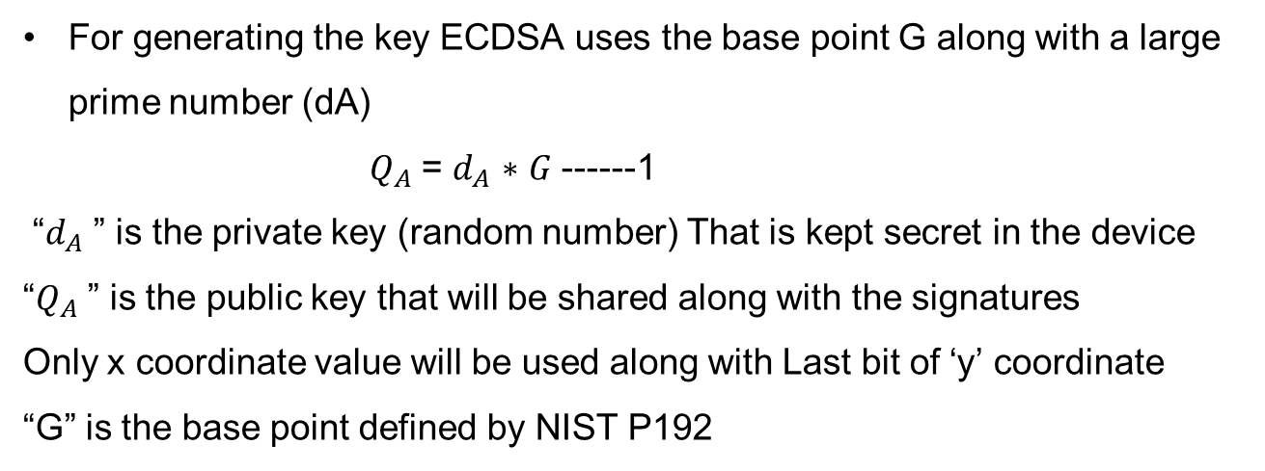
Key generation
For generating the key ECDSA uses the base point G along with a large prime number (dA)
$Q_{A}$ = $d_{A}$ ∗ 𝐺 ------1
“$d_{A}$ ” is the private key (random number) That is kept secret in the device
“$Q_{A}$ ” is the public key that will be shared along with the signatures
Only x coordinate value will be used along with Last bit of ‘y’ coordinate
“G” is the base point defined by NIST P192

Slide 12
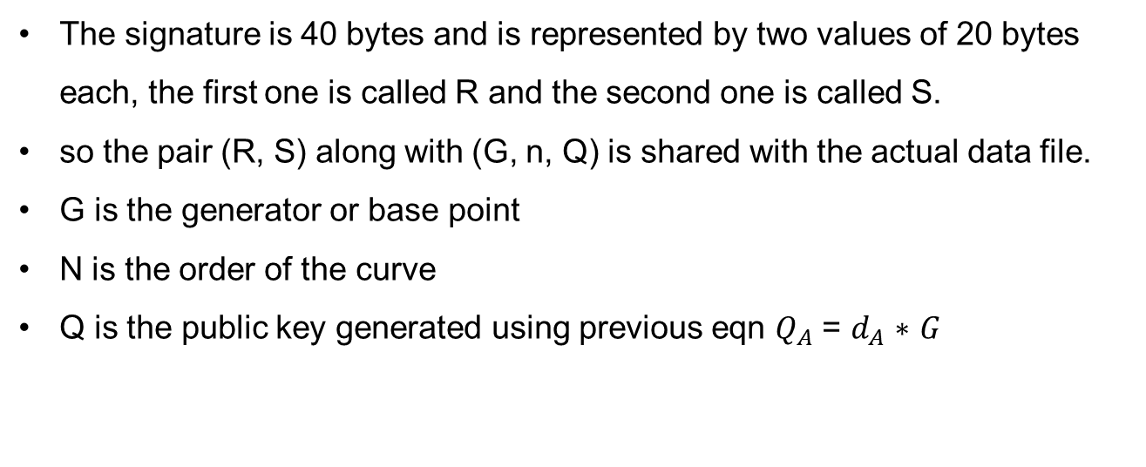
Signature Generation Using ECDSA :
The signature is 40 bytes and is represented by two values of 20 bytes each, the first one is called R and the second one is called S.
so the pair (R, S) along with (G, n, Q) is shared with the actual data file.
G is the generator or base point
N is the order of the curve
Q is the public key generated using previous eqn $Q_{A}$ = $d_{A}$ ∗ 𝐺

Slide 13
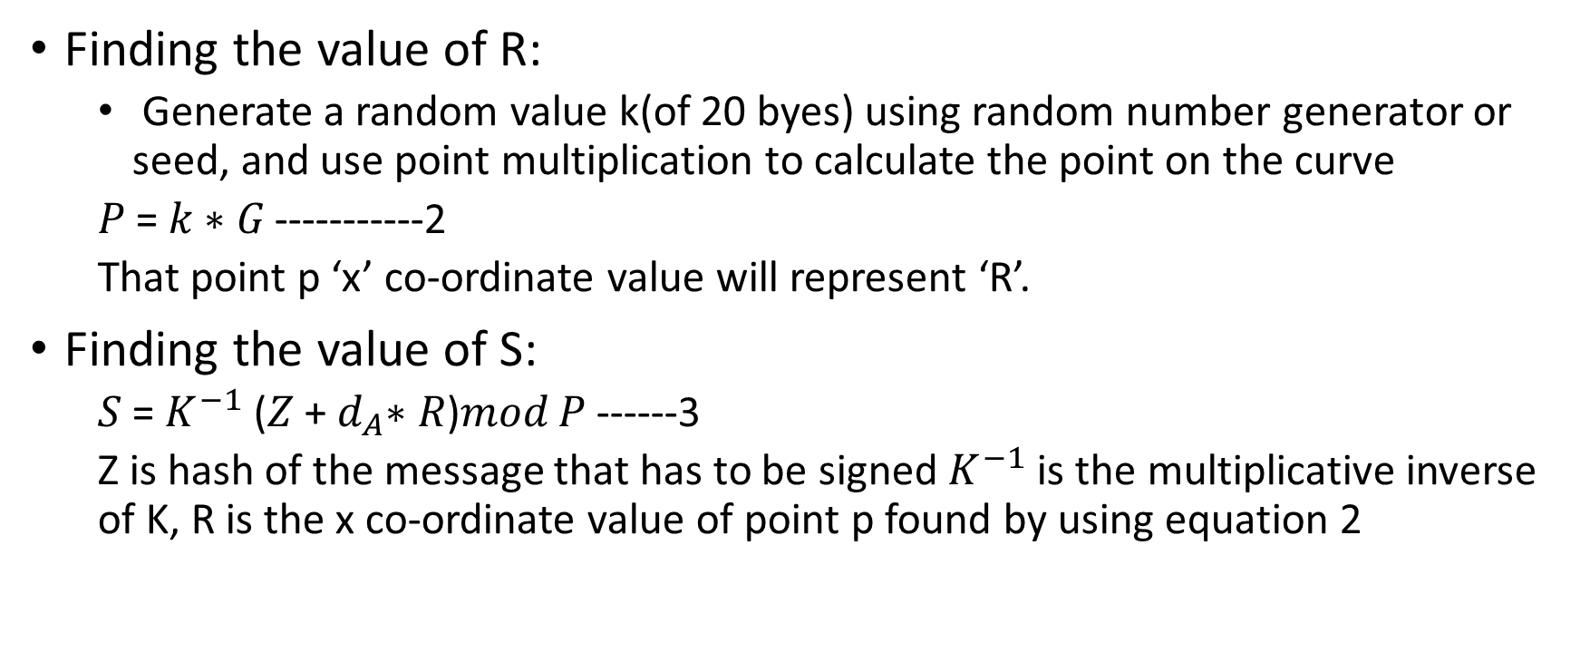
Finding the value of R and S
Finding the value of R:
Generate a random value k(of 20 byes) using random number generator or seed, and use point multiplication to calculate the point on the curve
𝑃 = 𝑘 ∗ 𝐺 -----------2
That point p ‘x’ co-ordinate value will represent ‘R’.
Finding the value of S:
𝑆 = $K^{−1}$ (𝑍 + $d_{A}$∗ 𝑅)𝑚𝑜𝑑 𝑃 ------3
Z is hash of the message that has to be signed $K^{−1}$ is the multiplicative inverse of K, R is the x co-ordinate value of point p found by using equation 2

Slide 14
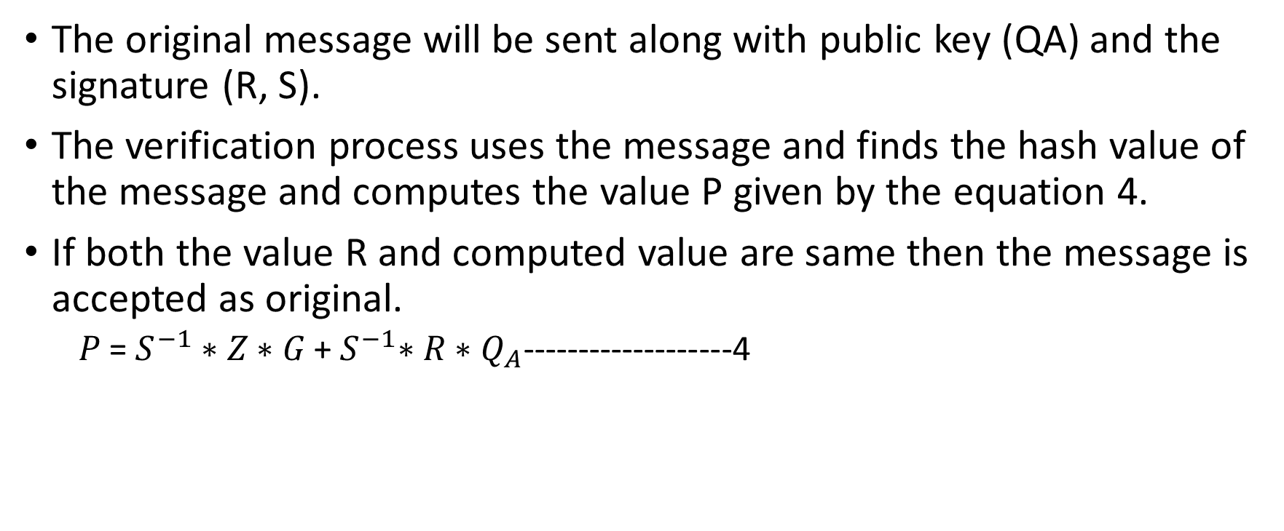
Verifying the sign
The original message will be sent along with public key (QA) and the signature (R, S).
The verification process uses the message and finds the hash value of the message and computes the value P given by the equation 4.
If both the value R and computed value are same then the message is accepted as original.
𝑃 = $S^{−1}∗$ 𝑍 ∗ 𝐺 + $S^{−1}$∗ 𝑅 ∗ $Q_{A}$-------------------4

Slide 15
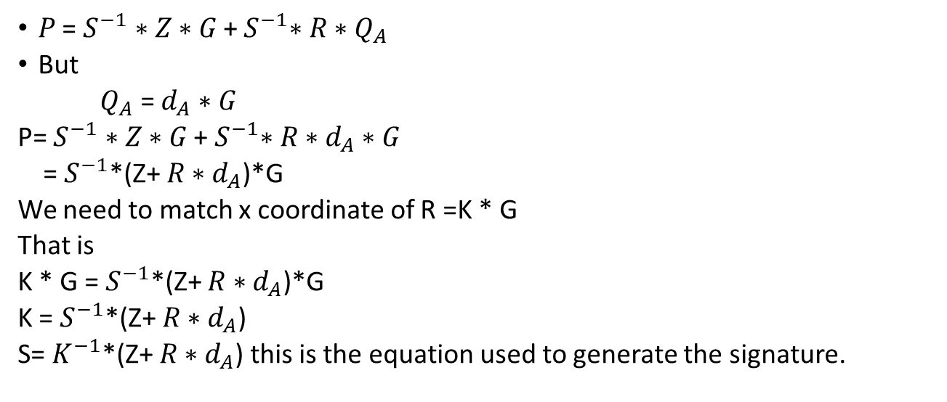
HOW?
𝑃 = $S^{−1}∗$ 𝑍 ∗ 𝐺 + $S^{−1}$∗ 𝑅 ∗ $Q_{A}$
But
$Q_{A}$ = $d_{A}$ ∗ 𝐺
P= $S^{−1}∗$ 𝑍 ∗ 𝐺 + $S^{−1}$∗ 𝑅 ∗ $d_{A}$ ∗ 𝐺
= $S^{−1}$*(Z+ 𝑅 ∗ $d_{A}$)*G
We need to match x coordinate of R =K * G
That is
K * G = $S^{−1}$*(Z+ 𝑅 ∗ $d_{A}$)*G
K = $S^{−1}$*(Z+ 𝑅 ∗ $d_{A}$)
S= $K^{−1}$*(Z+ 𝑅 ∗ $d_{A}$) this is the equation used to generate the signature.

Slide 16
Thank You!
Next Class
Mandatory reading for the next class
https://nvlpubs.nist.gov/nistpubs/FIPS/NIST.FIPS.186-4.pdf
16

Slide 17


Rajashree S
Computer Science and Engineering
PES University, Bengaluru
10 June 2020
17

